Slide 1
Strengthening the Child Care Workforce
PHX East Valley Partnership

Slide 2
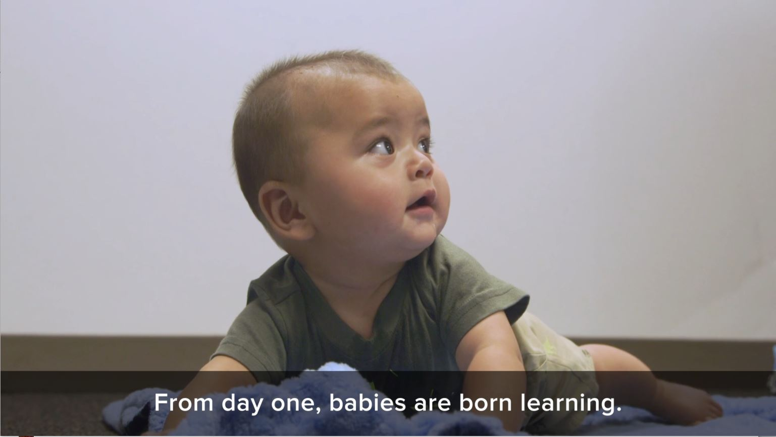
Notes:
Baby Brain: Brain Growth [1:26]

Slide 3
Child care is a full-blown crisis for Arizona Educators, business leaders and policymakers must work together

Slide 4
In 4 FTF regions that include the East Valley and Phoenix, there are more than a quarter million children under age 6
Notes:
FTF East Maricopa Region, there are 54,701 children (under age 6) with 14% living in poverty.
FTF Southeast Maricopa Region, there are 68,471 children (under age 6) with 19% living in poverty.
FTF Phoenix North Region, there are 66,337 children (under age 6) with 24% living in poverty.
FTF Phoenix South Region, there are 65,037 children (under age 6) with 42% living in poverty.

Slide 5
Child care impacts the workforce of today and tomorrow. And, it's gaining national attention
Federal CHIPS Act
Biden Executive Order
Notes:
Last year, lawmakers passed the CHIPS and Science Act, which invests more than $200 billion over five years to help the US bring back semiconductor chip manufacturing from places like China. The law is not specifically about child care, but now the Commerce Department is requiring some companies to also provide access to child care in order to be eligible for the money. In addition to submitting workforce development plans, applicants requesting Direct Funding over $150 million must submit a plan to provide their facility and construction workers with access to child care. This first-of-its kind commitment will be essential to getting people—especially women—into the workforce. A recent review of research on child care costs and women’s labor supply found that a 10 percent decrease in the cost of child care leads to a 0.5 to 2.5 percent increase in maternal employment. That effect is even stronger for mothers with lower incomes. If women participated in the labor force at the same rate as men, there would be more than 10 million additional workers. Making it easier for women to join the workforce will therefore be critical to the success of individual projects and of the program as a whole.

Slide 6
Current statistics for Arizona providers
90% have staffing shortages
27% have longer waitlists
20% have unopened classrooms
23% have reduced operating hours
45% struggle to recruit new staff
Cost of care has increased 6-27%

Slide 7
Current wages for child care providers
The median wage is $13.22/hour
Economic Policy Institute estimates they should be paid $21.11 - $25.95

Slide 8
Employee benefits are often limited
4 out of 5 have no employer-sponsored health insurance
9 out of 10 have no retirement
Child care employers face competition from other industries
Notes:
In addition to the limited benefit and wages, child care providers are competing with employers who:
require little experience
pay more
offer more benefits

Slide 9
Families can’t afford to pay more

Slide 10
Infant care costs
more than sending a student to an in-state university
20% of a median family’s income in Arizona
44% of a minimum wage worker’s salary

Slide 11
Child care is affordable if it costs 7% or less of a family’s income.
Less than 9% of Arizona families can afford infant care.

Slide 12
Impact of child care crisis on Arizona’s economy

Slide 13
Due to child care issues
Arizona estimated a $1.7 billion loss annually to our economy
the state loses $348 million in tax revenue annually
Arizona employers lose $1.42 billion loss annually due to absences and employee turnover
Notes:
10 percent decrease in the
cost of child care leads to a 0.5 to 2.5 percent increase in maternal employment. That effect is even stronger for
mothers with lower incomes. If women participated in the labor force at the same rate as men, there would be
more than 10 million additional workers. Making it easier for women to join the workforce will therefore be
critical to the success of individual projects and of the program as a whole.

Slide 14
$1.2 billion in federal assistance has been a lifeline

Slide 15
Funds run out in 2024

Slide 16
3 strategies to address high operational costs and the workforce crisis
Stabilization grants
Workforce grants
Subsidy reimbursement rates

Slide 17
Businesses can help

Slide 18
We need your support

Slide 19
Thank you.

